Slide 1

ITE61
Software and Vendor Selection

Slide 2

ITE61
Vendor Research
The first step in selecting an ERP system is generally to research vendor ERP systems on the market and to identify a short list of vendors who will help to shape business requirements. This process is especially helpful for companies moving from aging legacy systems and technology to current and state-of-the-art technology.

Slide 3

The following should be considered when researching vendors and gathering information:
• Other businesses using the vendor
• The vendor’s financial position
• The vendor’s implementation philosophy and support issues
• The hardware and software infrastructure used to support the ERP
• The vendor’s direction and currency of software
• The vendor’s release and upgrade strategies
• The vendor’s user-base involvement in defining future functional changes
• The vendor’s development and maintenance resources

Slide 4
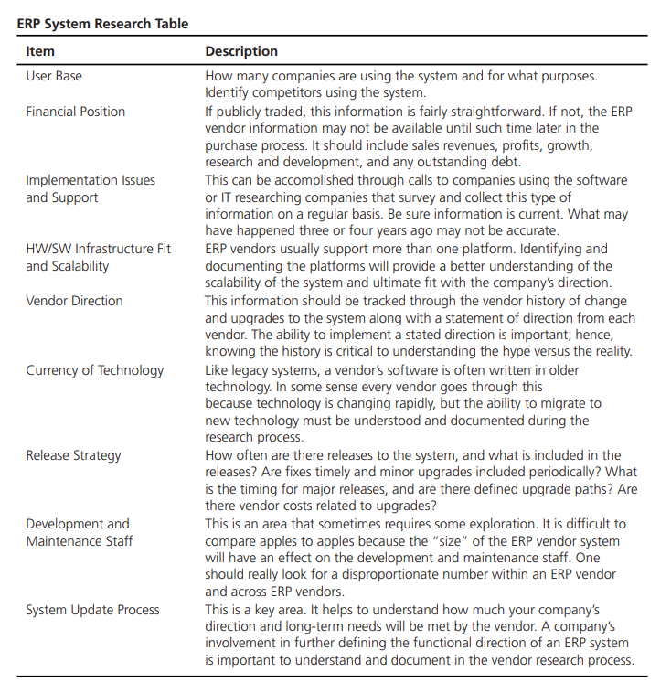
The ERP System Research Table

Slide 5
SAP—Founded in 1972, SAP is the recognized leader among ERP vendors, currently claiming the largest market share. Its solutions are for all types of industries and for every major market.
Lawson—Founded in 1975, Lawson provides industry-tailored software solutions. Lawson’s solutions include enterprise performance management, distribution, financials, human resources, procurement, retail operations, and service process optimization
SSA Global—By acquiring Baan in 2004, SSA Global effectively doubled the company’s size. They claim to offer solutions that accomplish specific goals in shorter time frames and that they are more efficient with time.
Oracle/PeopleSoft—Oracle technology can be found in nearly every industry around the world and in the offices of 98 of the Fortune 100 companies. Oracle is the first software company to develop and deploy 100 percent Internet-enabled enterprise software across its entire product line: databases, business applications, and application development and decision support tools
Great Plains—Great Plains offers integrated capabilities for financial management, distribution, manufacturing, project accounting, HR management, field service management, and business analytics.
Infor Visual—This ERP software is a flexible, fully integrated, and easy-to-use ERP suite that is widely deployed across many different types of industries from aerospace to biomedical, capital equipment, precision tools, and more.
Epicor—Epicor focuses on enterprise software solutions for midmarket companies around the world. The company claims to have solutions to a variety of needs, whether a customer is looking for a complete end-to-end enterprise software solution or a specific application.
Infor Visual—This ERP software is a flexible, fully integrated, and easy-to-use ERP suite that is widely deployed across many different types of industries from aerospace to biomedical, capital equipment, precision tools, and more.
ERP Vendors

Slide 6

ITE61
Matching User Requirements
Traditionally, the identification and documentation of user and system requirements can be done as an exercise by documenting current legacy system functionality and using business process reengineering to address “best practices” in the industry.
Two major documents are often a result of the functional requirements process. The first is a data and functional flow of departmental or business processes, including any changes to those processes; the second is a table or description of functions in each department and the level of importance of each function.

Slide 7
ITE61
Matching User Requirements
The second approach to identifying ERP functionality with organization requirements is by conducting a fit/gap. Fit/gaps is a step in the implementation process but has been usually completed after the ERP has been purchased.
The fit/gap process has the vendor walking the organization through the ERP functionality. The organization can then see what works for them, what business processes will need to change, and what changes are necessary for the ERP to work for the organization.

Slide 8
ITE61
Request for Bids
The bid process in private industry is not required, but in public institutions it almost always is. It is an expensive and time-consuming process for both the company and vendor(s), but it can yield significant software savings when done right.
The request for bids (RFB), which is sometimes called request for proposals (RFP), should include the type of ERP system the company wants with specific functionality, along with a specified hardware and software infrastructure, training requirements, and any specific contract issues required by the company

Slide 9
ITE61
Vendor Analysis and Elimination
The task of evaluating ERP system bids will take organizing and planning. There will be many components to a bid that require many different skill sets. Office staff will need to evaluate functionality, IT staff will evaluate the technology requirements, and contract staff will need to evaluate the contract and pricing of the system
The bid evaluation and any vendor discussions should focus on the best fit. It is important to understand that no vendor will meet all the requirements.
Last, develop and analyze the total cost of ownership. This can be difficult, but it should be inclusive of all costs.

Slide 10
ITE61
Contract Management
It is very appropriate to enter into contract negotiations for the product, services, and maintenance after evaluating ERP vendors based on fact and narrowing the number of possibilities down to one or two. If there are two vendors, it is best to help understand the value of each product and create a competition between the competing vendors.
In discussions with the vendor(s), the talks should center on the products included in the purchase and maintenance terms of each product. Terms and conditions will be a significant part of the contract and will be addressed by the buyers, contract attorneys.

Slide 11
ITE61
Contract Management
During discussions with the vendor(s), contract life cycle management will need to be addressed. There are certain aspects that should be present in every ERP contract that will increase the chances of a successful purchase and implementation.
There will be more of a focus on the program manager and the change management process after the purchase of an ERP system. This is preferable to ensure the ERP implementation success and highlight the importance of a contract manager. The program manager must appoint a contract quality manager or contract monitor.

Slide 12

ITE61
Thank You For Your Attention!

